Slide 1
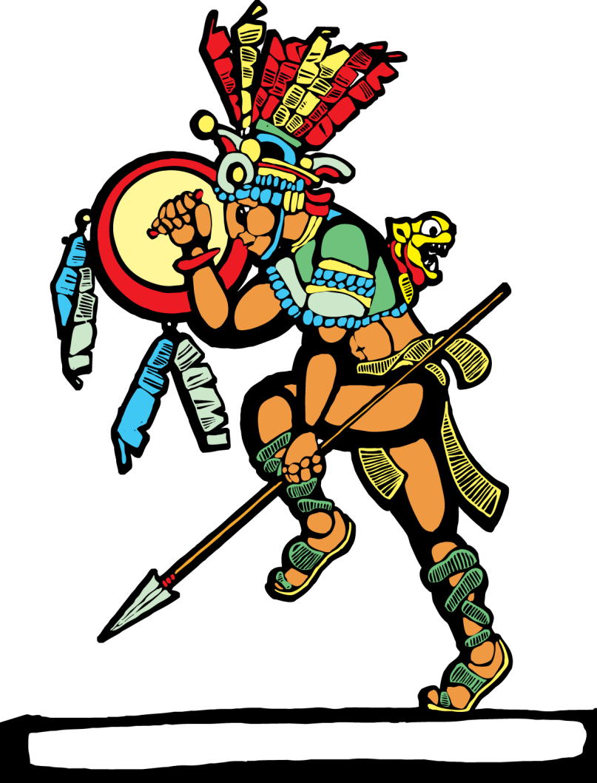
Gender of Nouns: Definite and Indefinite Articles
Is it masculine or feminine?

Slide 2
All Spanish nouns have gender. This means that they are assigned the gender of either masculine or feminine depending upon the ending and the meanings of the nouns.
There are rules that govern whether a noun is masculine or feminine.

Slide 3
All Spanish nouns have GENDER
Most nouns that end in “o” or refer to
males are masculine.
Ejemplos:
el libro = book
el cuaderno = notebook
el hijo = son
el profesor = teacher (male)
el hombre = man
el padre = father

Slide 4
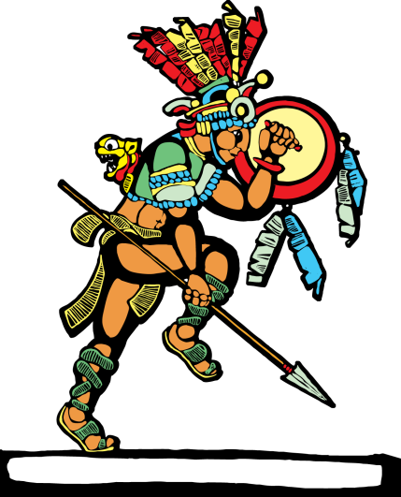
All Spanish nouns have GENDER
Most nouns that end in “a” or refer to females are feminine.
Ejemplos:
la silla = chair
la servilleta = napkin
la madre = mother
la profesora = teacher (female)
la mujer = woman
la mesa = table

Slide 5
Some nouns are masculine and they end in “MA” or “a.”
They don’t follow the rules and
have to be memorized!!!
Ejemplos:
el día = day
el mapa = map
el clima = climate
el idioma = language
el programa = program
el poema = poem

Slide 6
Some NOUNS that end in “o” are feminine and don’t follow the rules.
These must be memorized too!
Ejemplos:
la mano = hand
la radio = radio
la foto = photograph
la moto = motorcycle

Slide 7
Nouns that end in “e” or
a consonant cannot usually be predicted and should be memorized.
Ejemplos:
el lápiz = pencil
el papel = paper
el arroz = rice
el cobre = copper
la piel = skin
la luz = light
la clase = class

Slide 8
Nouns that have the following endings are usually feminine:
Ejemplos:
–dad
–tad
–tud
–umbre
–ión
–ie
–nza
–ez
–eza
–sis
–itis
–cia

Slide 9
Ejemplos of feminine nouns:
la ciudad = city
la verdad = truth
la nación = nation
la serie = series
la pereza = laziness
la crisis = crisis

Slide 10
The following nouns are masculine:
Days of Week - Ejemplo: el lunes
Months - Ejemplo: (el) enero
Numbers - Ejemplo: el quince
Colors (when used as nouns) -
Ejemplo: Me gusta el verde. = (I like green.)
Infinitives of Verbs (when used as nouns) -
Ejemplo: El pescar es divertido. = (Fishing is fun.)

Slide 11
4 ways to say “THE” Definite Articles in Spanish
A definite article refers to a specific thing,
like “the” book.
el
los
la
las
4 ways to say it :
If the noun is masculine singular, use el before it.
If it’s masculine plural, use los.
Ejemplo: el libro – los libros
If the noun is feminine singular, use la before it.
If it’s feminine plural, use las.
Ejemplo: la silla – las sillas

Slide 12
Indefinite Articles (In English: a, an or some)
These work the same as the 4 “THEs” in Spanish.
They refer to a non-specific noun, a book or some books.
The masculine singular form is
and the plural form is
Ejemplo: un libro – unos libros
The feminine singular form is
and the plural form is
Ejemplo: una silla – unas sillas
un
unos
una
unas

Slide 13
Ejemplos:
El profesor = The teacher
Los libros = The books
La manzana = The apple
Las oraciones = The sentences
Un pato = A duck
Una montaña = A mountain
Unos monos = Some monkeys
Unas fresas = Some strawberries

Slide 14
Check Your Knowledge!
Definite Article Indefinite Article Noun
el
la
los
las
el
los
la
las
un
una
unos
unas
un
unos
una
unas
libro
madre
gatos
papas
padre
días
luz
sillas

Slide 15
Grammar PowerPoint Presentations!
Credits
©2010 Teacher’s Discovery
Written by: Jami Sipe
Additional Information by:
Suzanne Rutkowski
Adriana Miretti
Order Today!
To get more of these Spanish
grammar presentations,
go to:
www.teachersdiscovery.com
Search: Grammar PowerPoints™

