Slide 1
Bailar

Slide 2

Hablar

Slide 3
escuchar

Slide 4

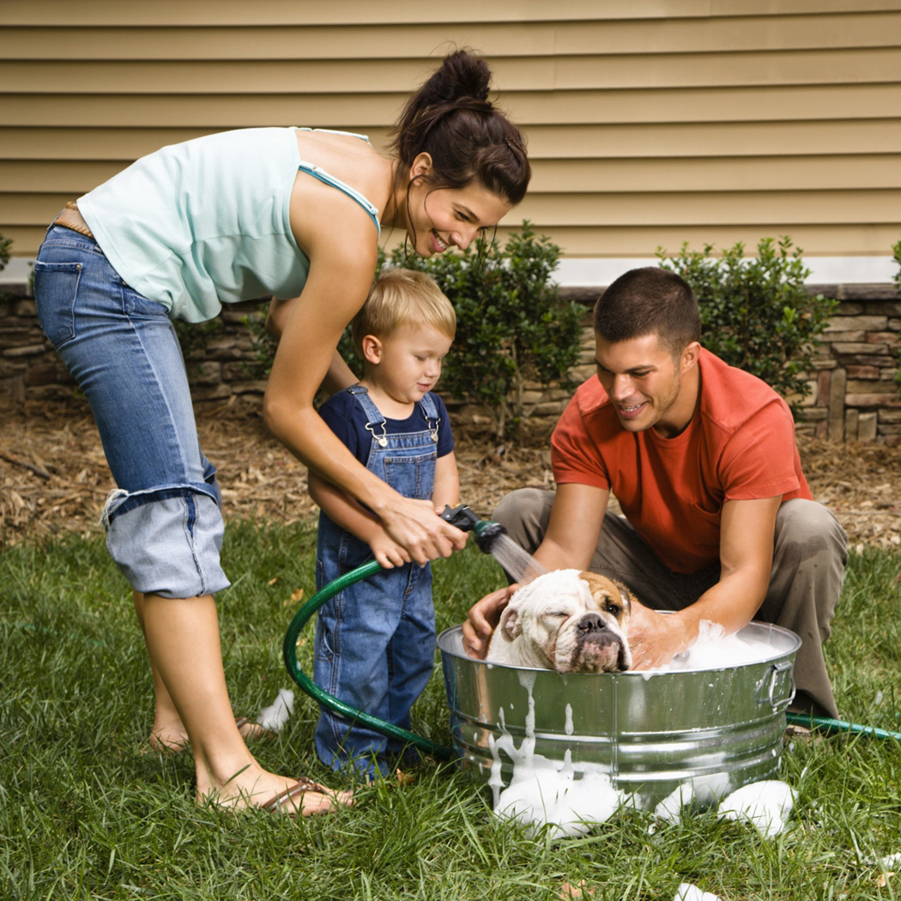
Lavar

Slide 5
Tocar

Slide 6
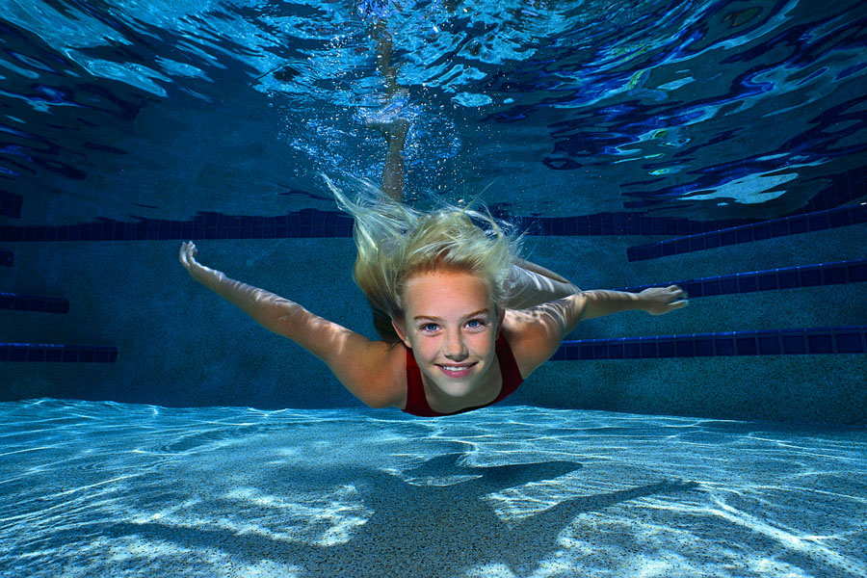
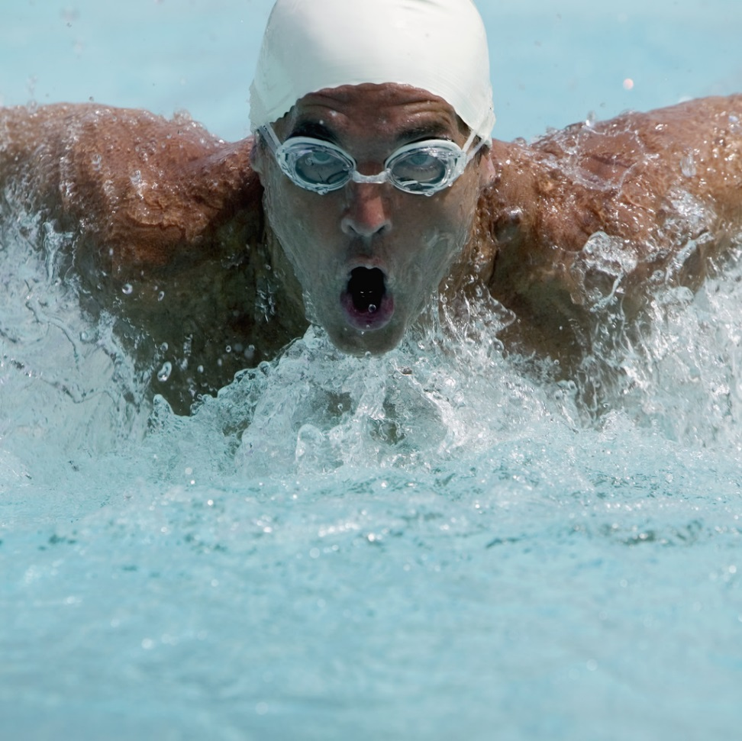
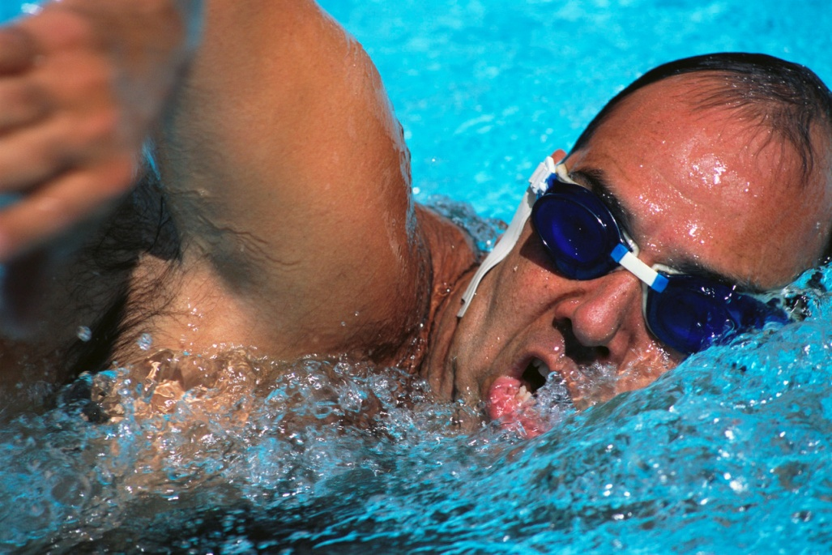
nadar

Slide 7
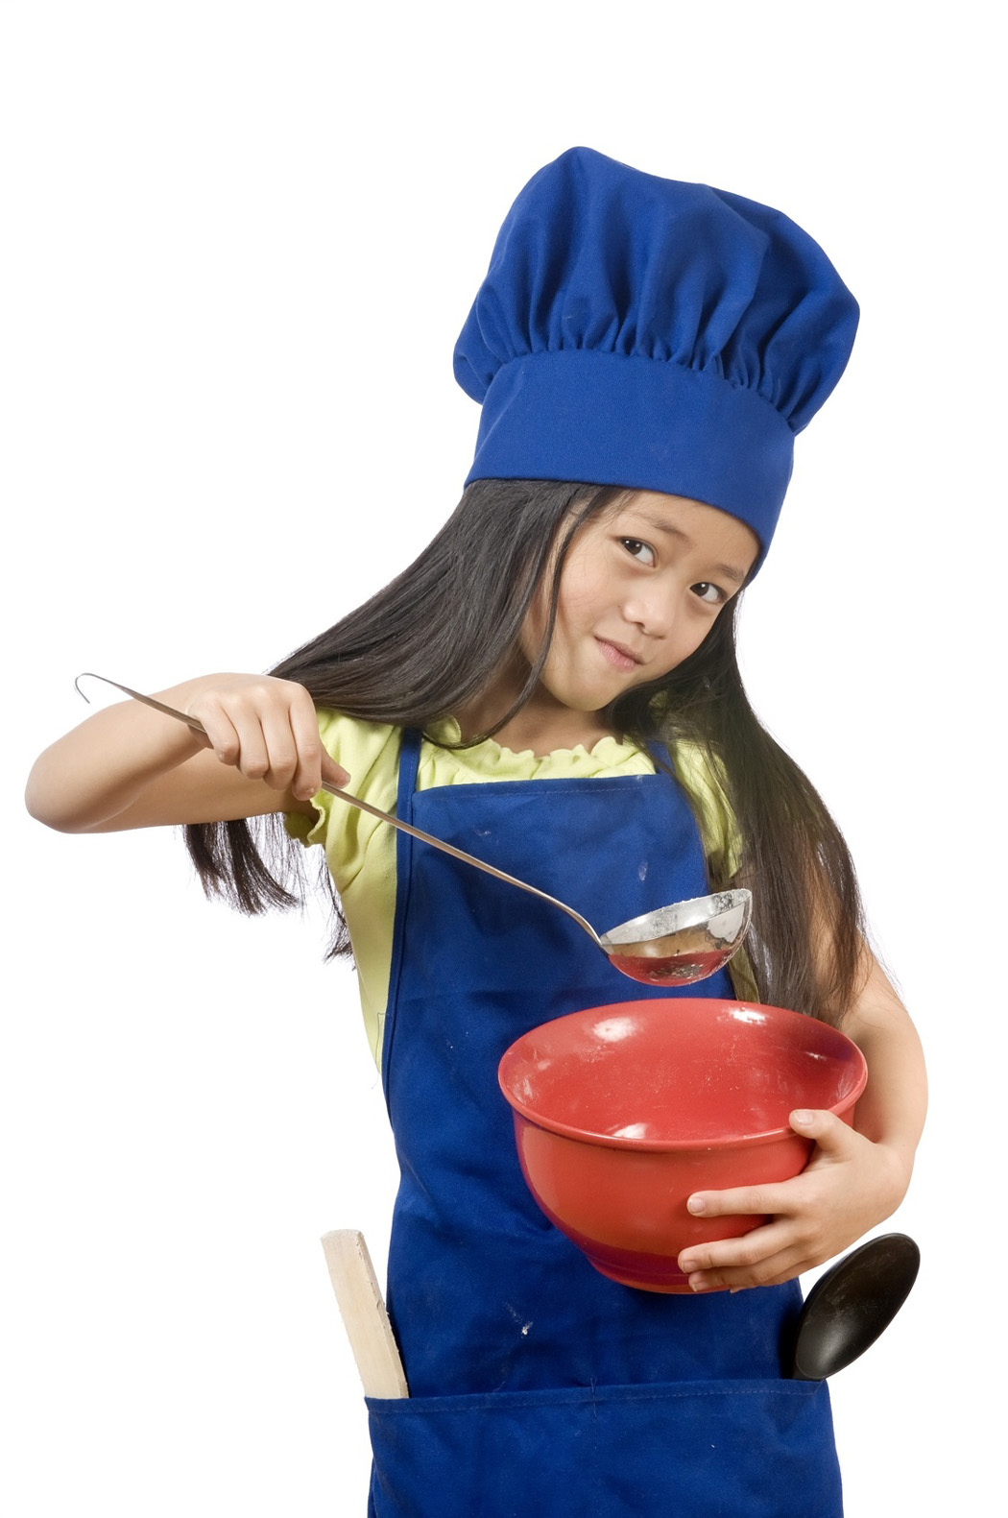
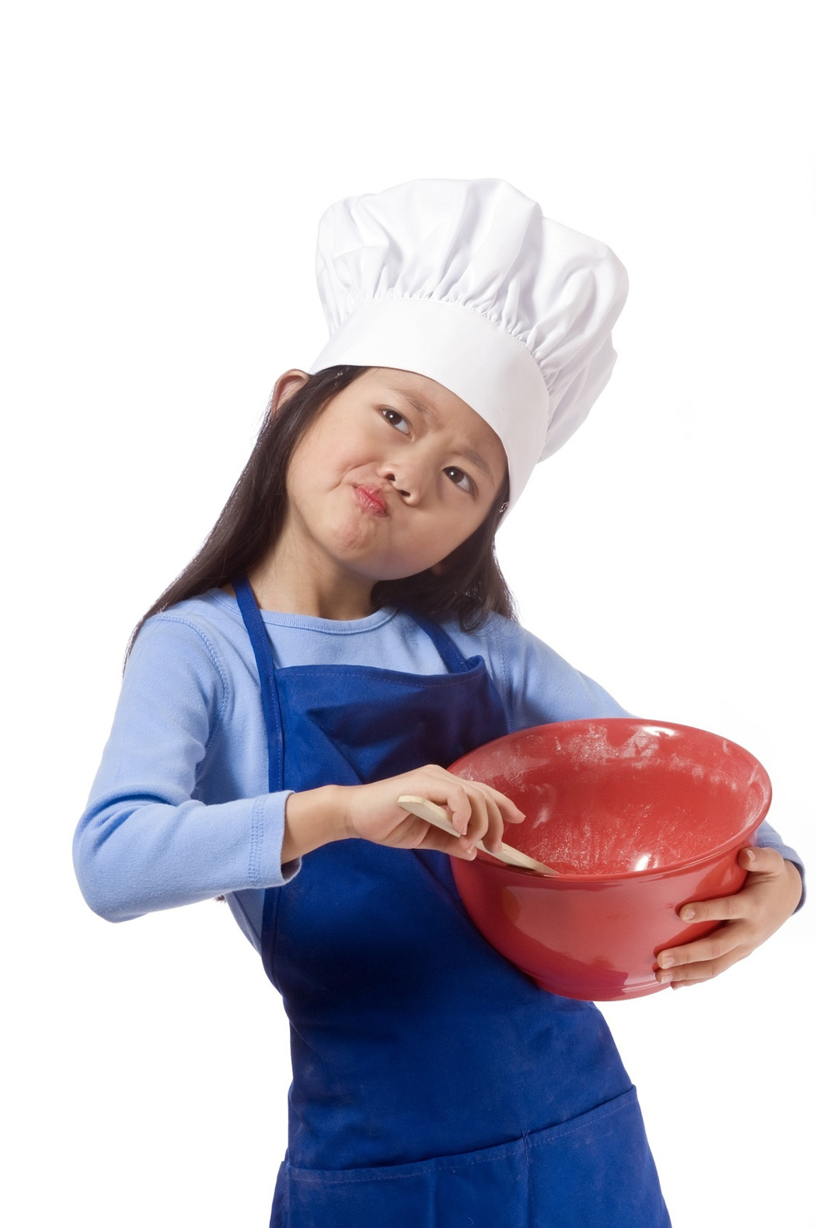
cocinar

Slide 8
pensar

Slide 9

jugar

Slide 10

tomar

Slide 11
dibujar

Slide 12


enseñar

Slide 13


contestar

Slide 14

C
O
M
P
R
A
R

Slide 15


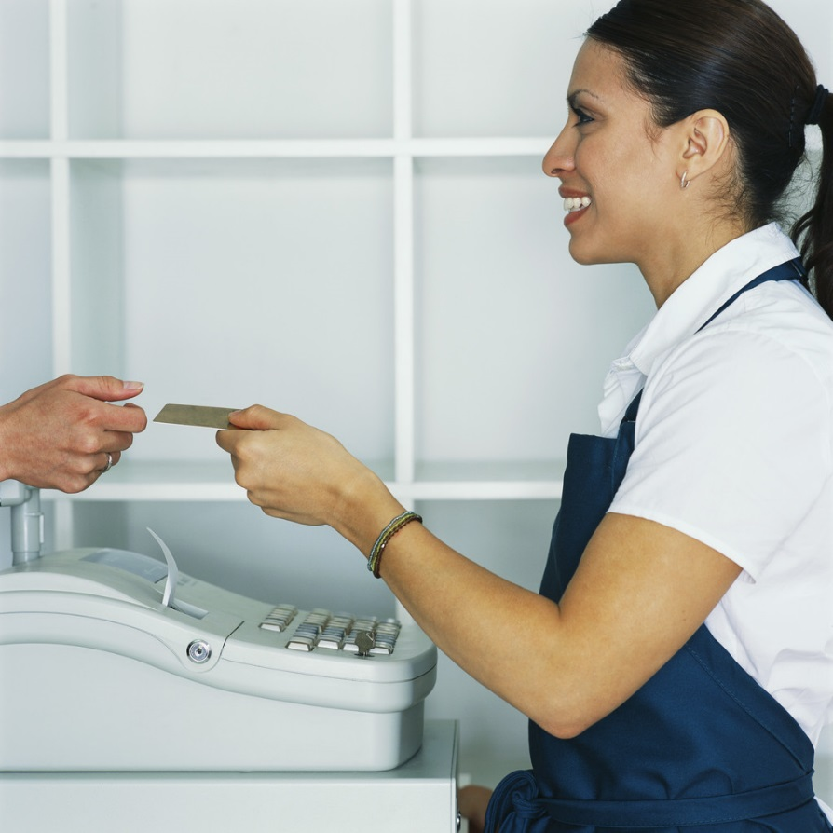
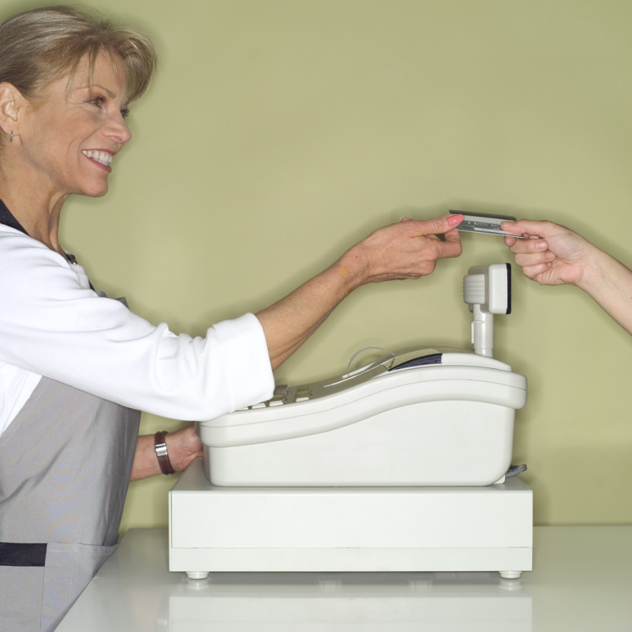
Pagar

Slide 16
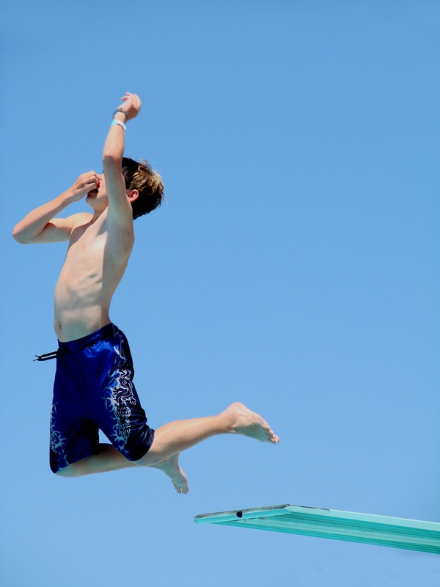
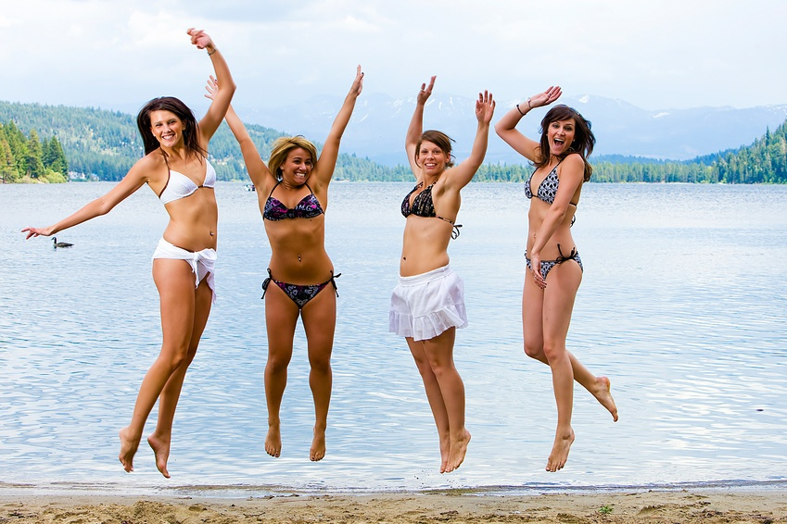
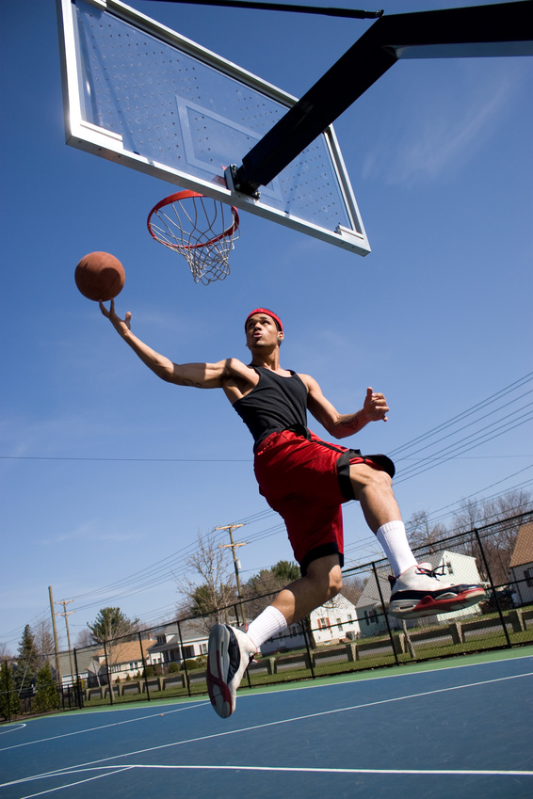
Saltar

Slide 17


Estudiar

Slide 18
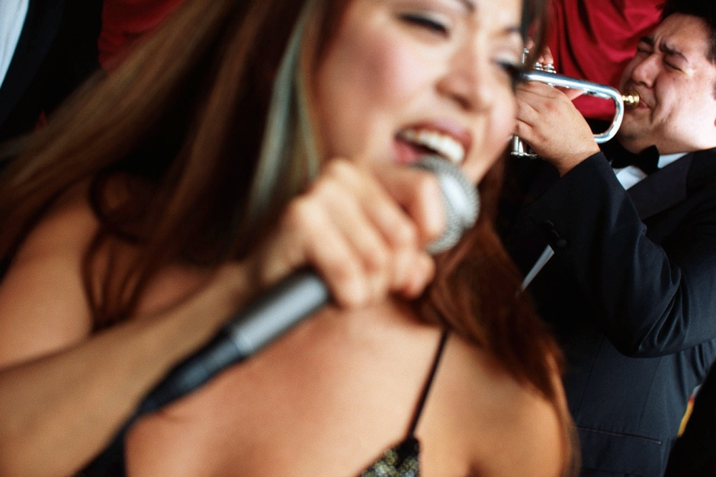

cantar

Slide 19
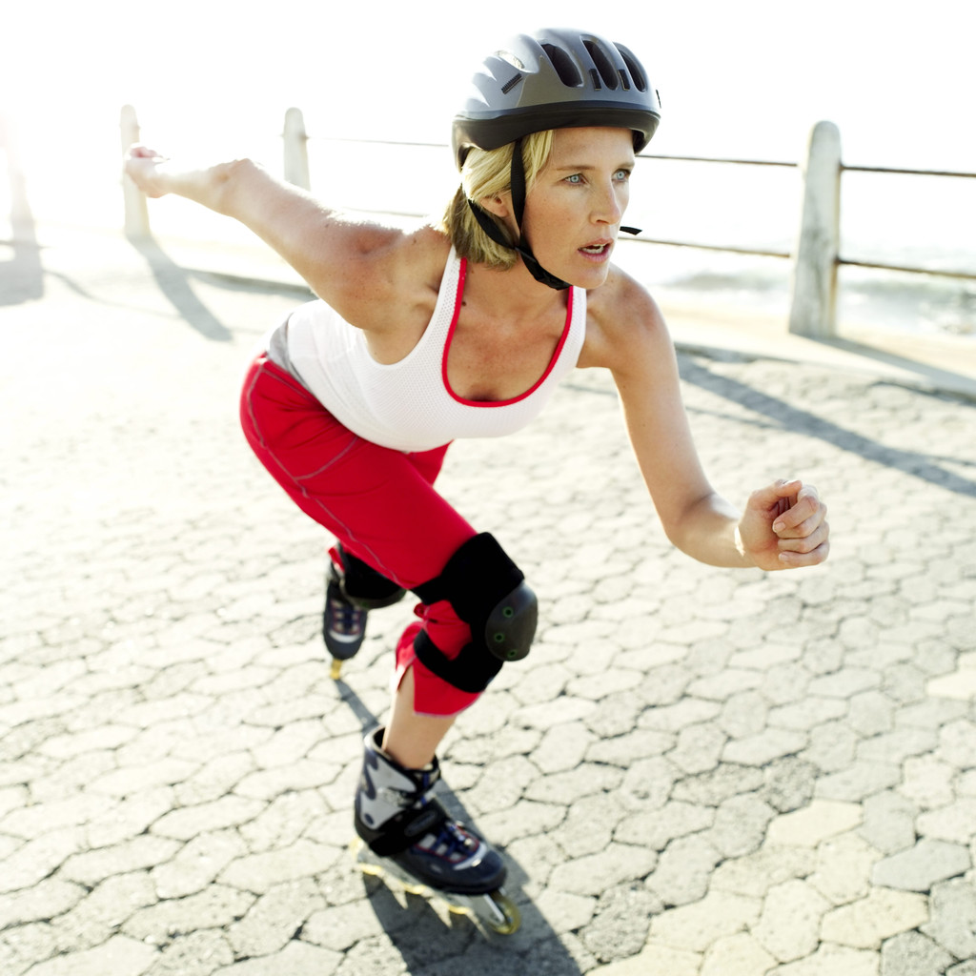
Patinar

Slide 20
Common –ar infinitives
Tomar= to take, to drink nadar= to swim
Entrar- to enter dar=to give
Llegar- to arrive necesitar= to need
Patinar= to skate cantar= to sing
Llevar= to take,to carry,to wear tocar= to play instument
Llamar= to call bailar= to dance
Mirar= to look at saltar= to jump
Cocinar= to cook comprar= to buy
Pensar= to think pagar= to pay for
Lavar= to wash escuchar= to listen
Jugar= to play enseñar= to teach,show
Hablar= to talk buscar= to look for
Dibujar= to draw estudiar= to study
Trabajar= to work contestar= to answer

Slide 21
Pasear- to walk
Descansar- to rest/relax
Montar- to ride
Andar- to walk

